Slide 1
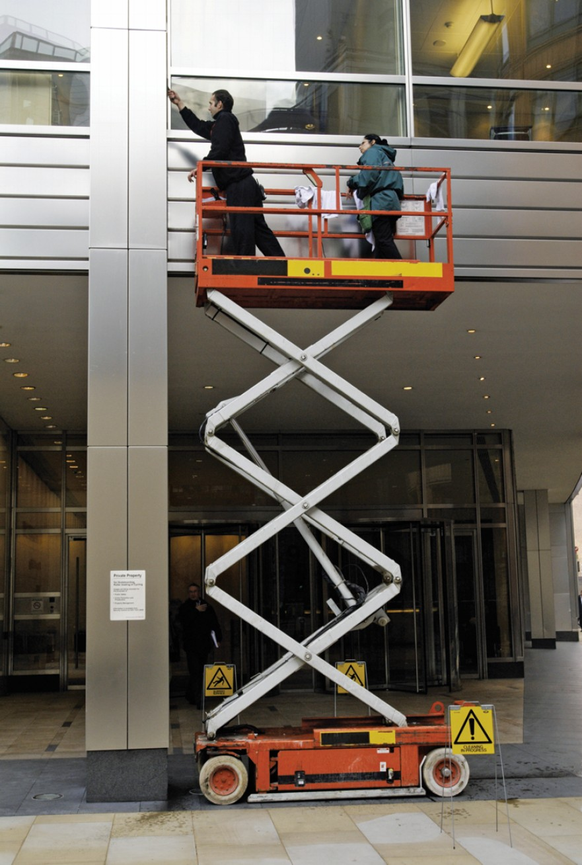
CHAPTER 7 VIRTUAL WORK
CHAPTER OUTLINE
7/1 Introduction
7/2 Work
7/3 Equilibrium
7/4 Potential Energy and Stability
BuildPix/(c)Construction Photography/Photoshoot

Slide 2
Article 7/1 Introduction
Introduction

Slide 3
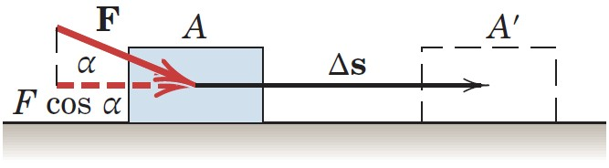
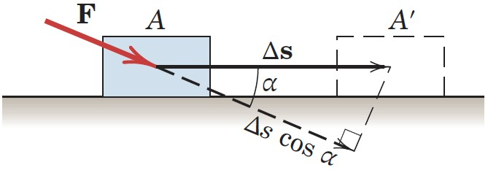
Article 7/2 Work
Work of a Force
Illustration
Calculation
U = (F cos α )Δs = F (Δs cos α)
Scalar Quantity

Slide 4
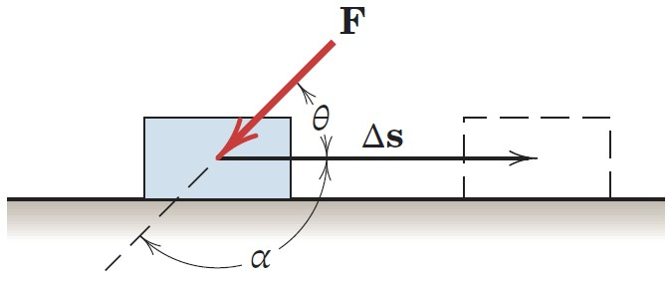
Article 7/2 – Sign Convention
Positive Work
Working component of F is in the same direction as the displacement.
Negative Work
Working component of F is in the opposite direction as the displacement.

Slide 5
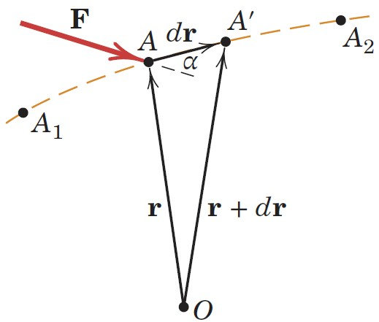
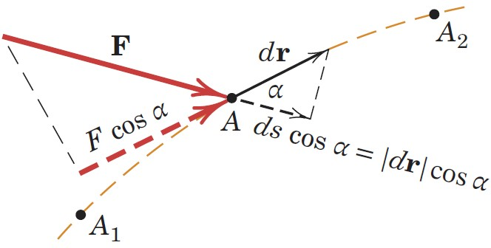
Article 7/2 – General Situation
General Illustration of Work by a Force
General Expression for Work by a Force
dU = F·dr

Slide 6
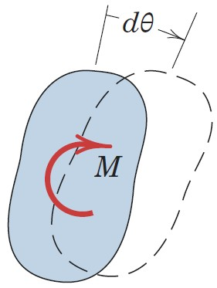
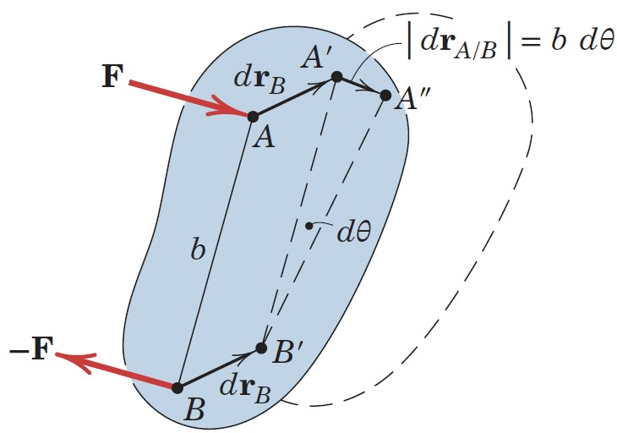
Article 7/2 – Work of a Couple
General Illustration of Work by a Couple
General Expression for Work by a Couple
dU = M dθ
Sign Convention
Positive if couple acts in the same sense as rotation.
Negative if couple acts in the opposite sense as rotation.

Slide 7
Article 7/2 – Dimensions and Units of Work
Dimensions
(Force) × (Distance)
SI Units
Joule (J)
J = N·m
U.S. Customary Units
foot-pound (ft-lb)
Not to be confused with moment which is pound-foot (lb-ft) and a vector quantity, whereas work is a scalar quantity.

Slide 8
Article 7/2 – Virtual Work
Virtual Displacement
Does not actually exist, but is assumed to exist.
Infinitesimal in size.
Consistent with the constrains of the system.
Instantaneous in time.
Virtual Work done by a Force and Couple
δU = F·dr or δU = F δs cos α
δU = M δθ

Slide 9
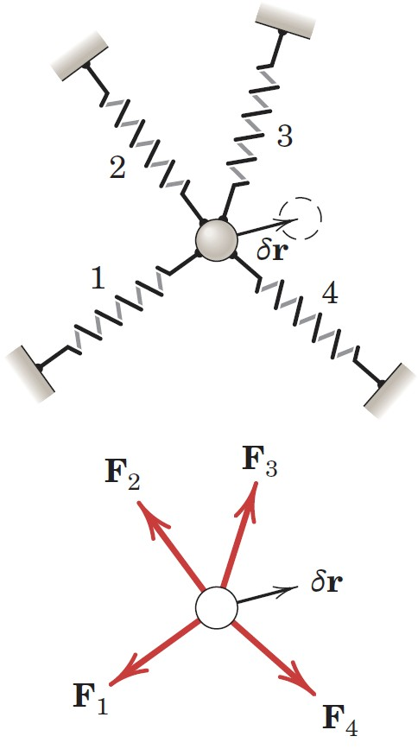
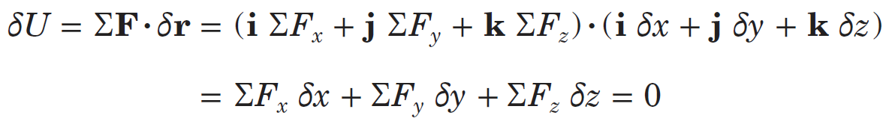
Article 7/3 Equilibrium
Equilibrium of a Particle
Virtual Work done on the Particle
Scalar Expression of Virtual Work
Result

Slide 10
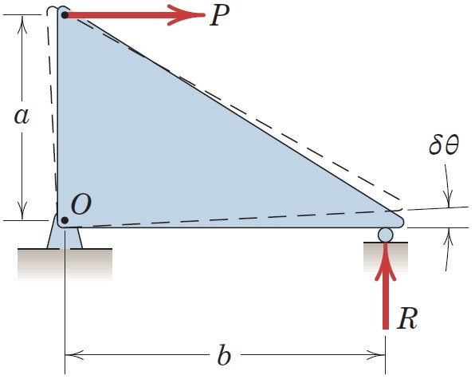
Article 7/3 – Equilibrium of a Rigid Body
Equilibrium of a Rigid Body
Determine the Roller Force, R
Virtual Work Calculation
δU = 0 = Rb δθ - Pa δθ
Result
Pa - Rb = 0
Equivalent to Moment Summation about Hinge O

Slide 11
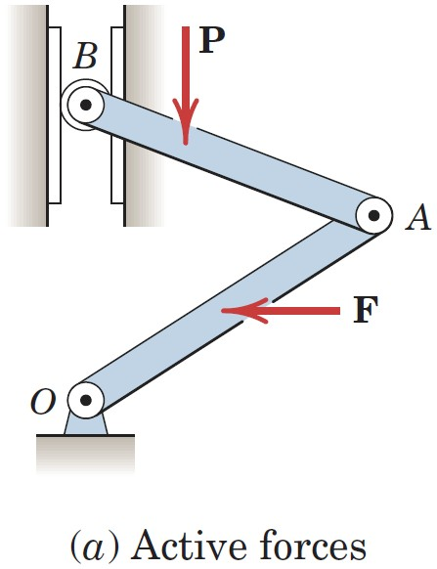
Article 7/3 – Equilibrium of Ideal Systems of Rigid Bodies
Ideal System
Friction is Neglected
Connections do not Absorb Energy
Example
Active Forces
Perform Virtual Work

Slide 12
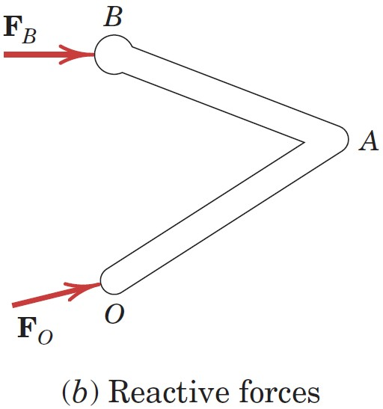
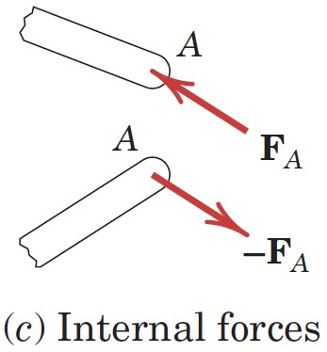
Article 7/3 – Other Types of Forces to Consider
Reactive Forces
Act at Fixed Locations
Do not Perform Virtual Work
Internal Forces
Occur in Equal and Opposite Pairs
Net Virtual Work is Zero

Slide 13
Article 7/3 – Principle of Virtual Work (1 of 2)
The Principle Stated
The virtual work done by external active forces on an ideal mechanical system in equilibrium is zero for any and all virtual displacements consistent with the constraints.
Mathematical Expression
δU = 0

Slide 14
Article 7/3 – Principle of Virtual Work (2 of 2)
Advantages of Virtual Work
It is not necessary to dismember ideal systems to establish the relations between active forces.
The relations between active forces may be determined directly without reference to the reactive forces.
General Comments
Method of virtual work requires internal friction forces do negligible work, or else the work by friction must be considered.
Construct an active-force diagram which shows only the active forces which act on the body. The reactive forces and internal forces do not perform any virtual work and do not need to be included.

Slide 15
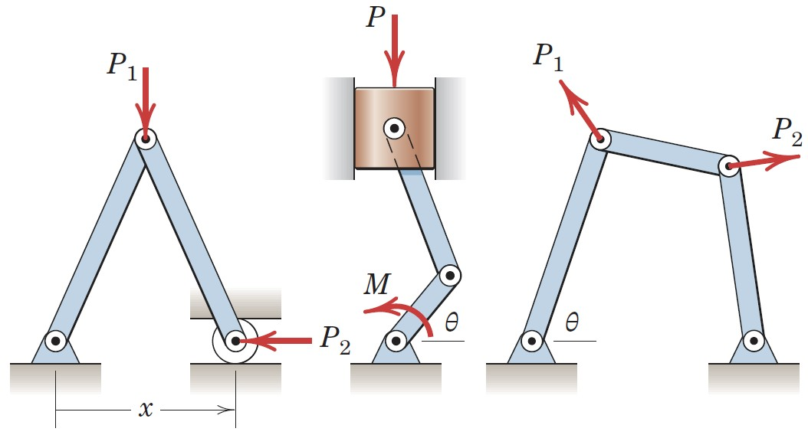
Article 7/3 – Degrees of Freedom (1 of 2)
Definition
The number of degrees of freedom of a mechanical system is the number of independent coordinates needed to specify completely the configuration of the system.
The principle of virtual work may be applied as many times as there are degrees of freedom.
With each application, allow only one independent coordinate to change at a time while holding the others constant.
One-Degree-of-Freedom Systems

Slide 16
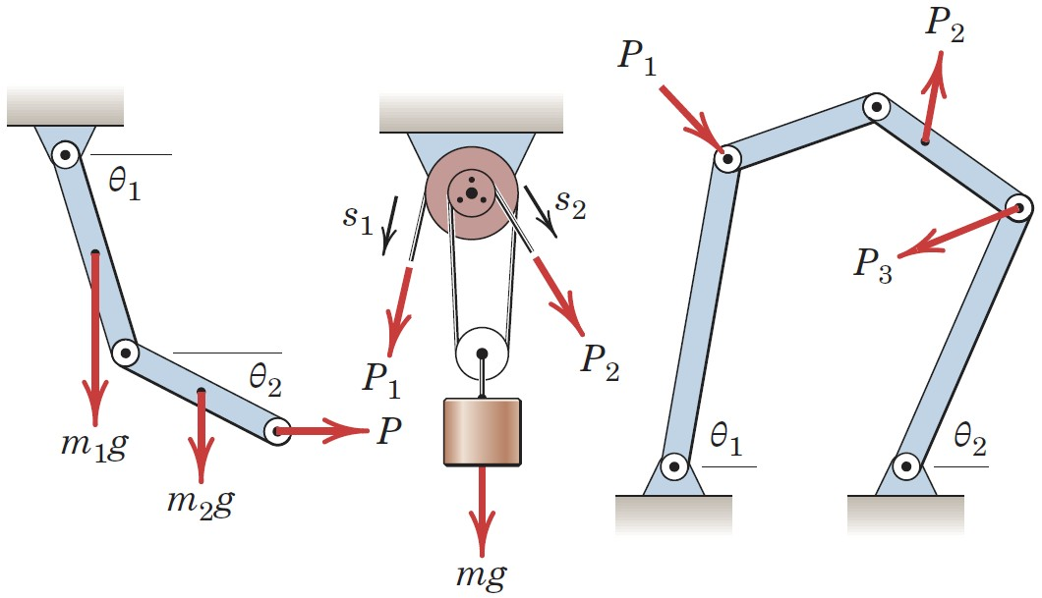
Article 7/3 – Degrees of Freedom (2 of 2)
Two-Degree-of-Freedom Systems

Slide 17
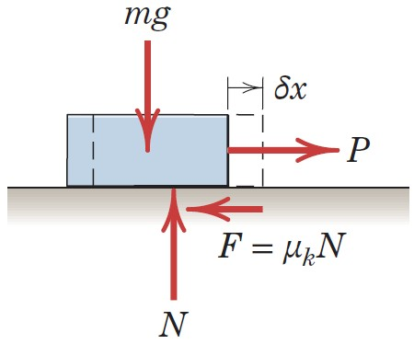
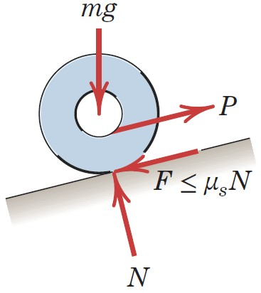
Article 7/3 – Systems with Friction (1 of 2)
Effect of Friction
Dissipates Positive Work by External Forces
Negative Work which cannot be Regained
Illustration with Sliding Block
Situation of a Rolling Wheel

Slide 18
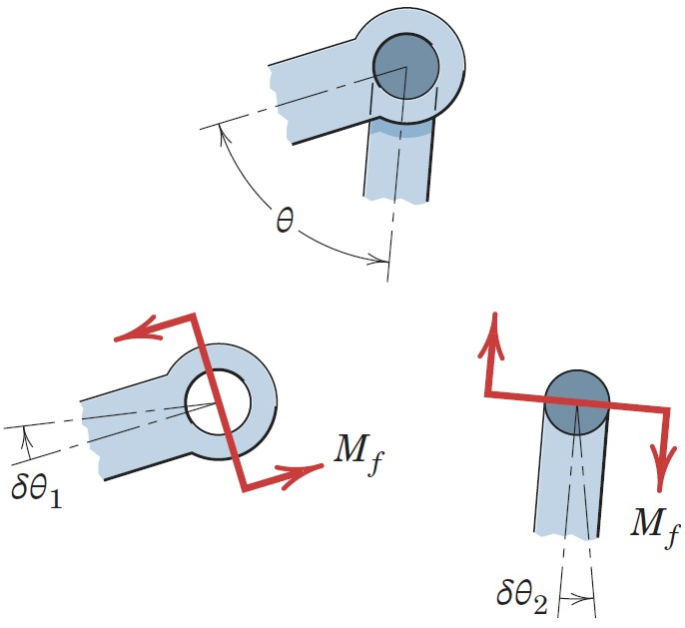
Article 7/3 – Systems with Friction (2 of 2)
Friction at a Pinned Connection

Slide 19
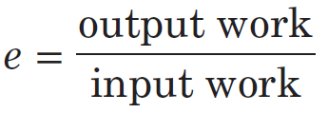
Article 7/3 – Mechanical Efficiency (1 of 3)
Efficiency Defined
Efficiency is the ratio of the output work from a machine and the input work to the machine.
Mathematical Expression

Slide 20
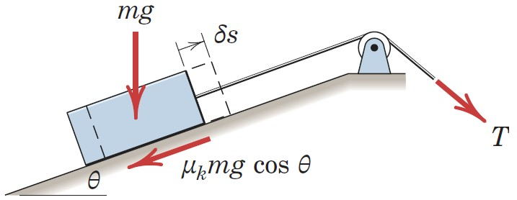
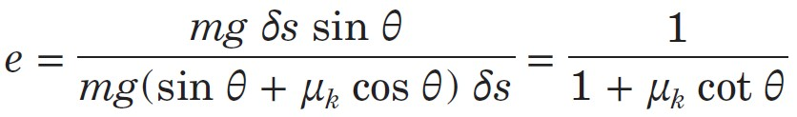
Article 7/3 – Mechanical Efficiency (2 of 3)
Example 1: Block Moving up an Incline
Efficiency

Slide 21
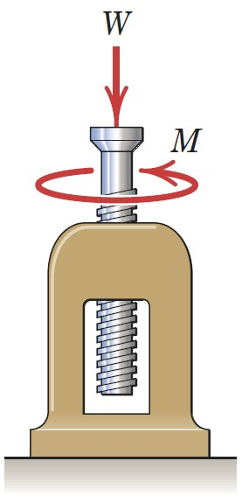
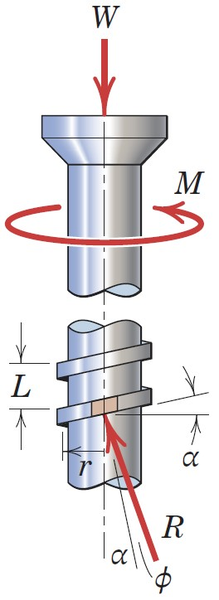
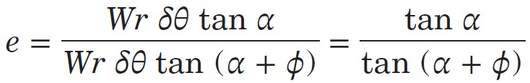
Article 7/3 – Mechanical Efficiency (3 of 3)
Example 2: Screw Jack
Efficiency

Slide 22
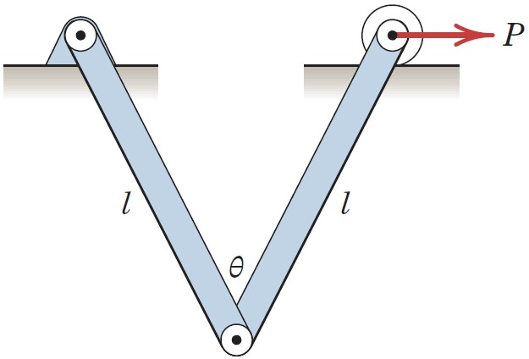
Article 7/3 – Sample Problem 7/1 (1 of 3)
Problem Statement
Each of the two uniform hinged bars has a mass m and a length l, and is supported and loaded as shown. For a given force P determine the angle 𝜃 for equilibrium.

Slide 23
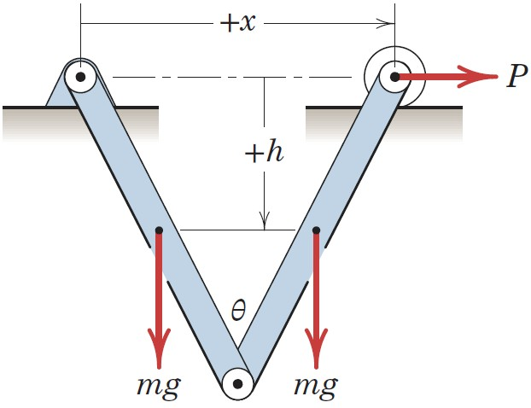
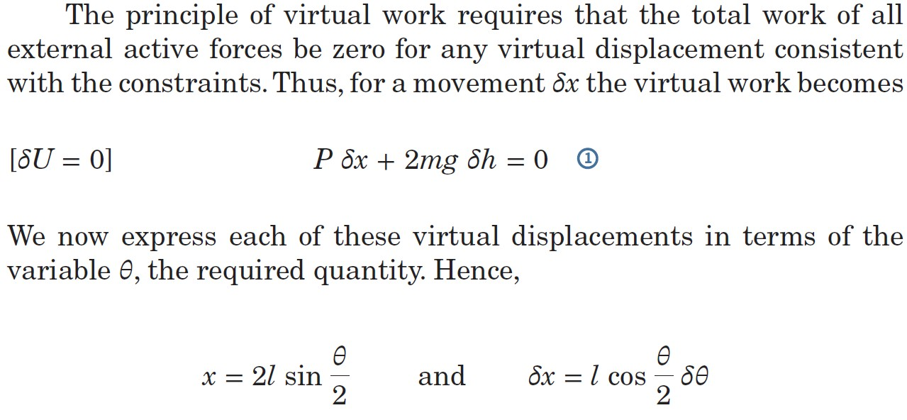
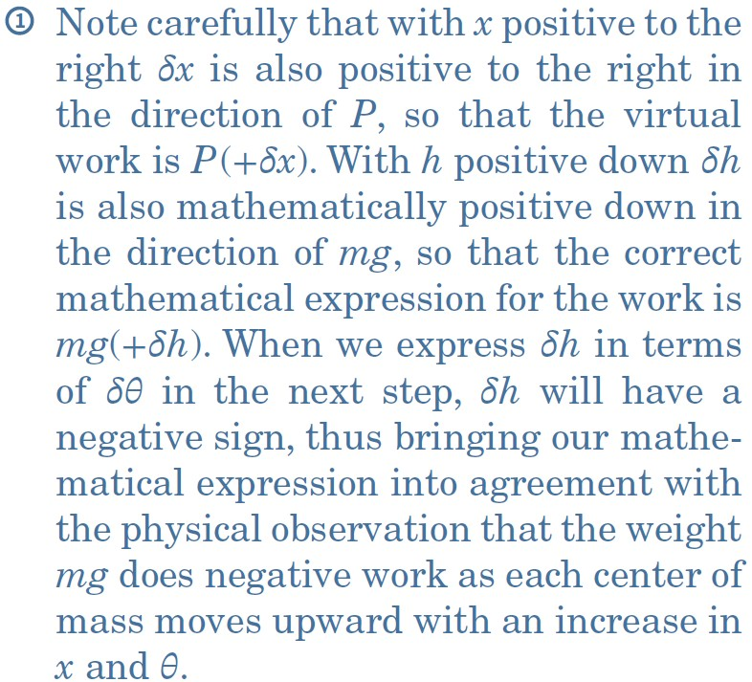
Article 7/3 – Sample Problem 7/1 (2 of 3)
Solution

Slide 24
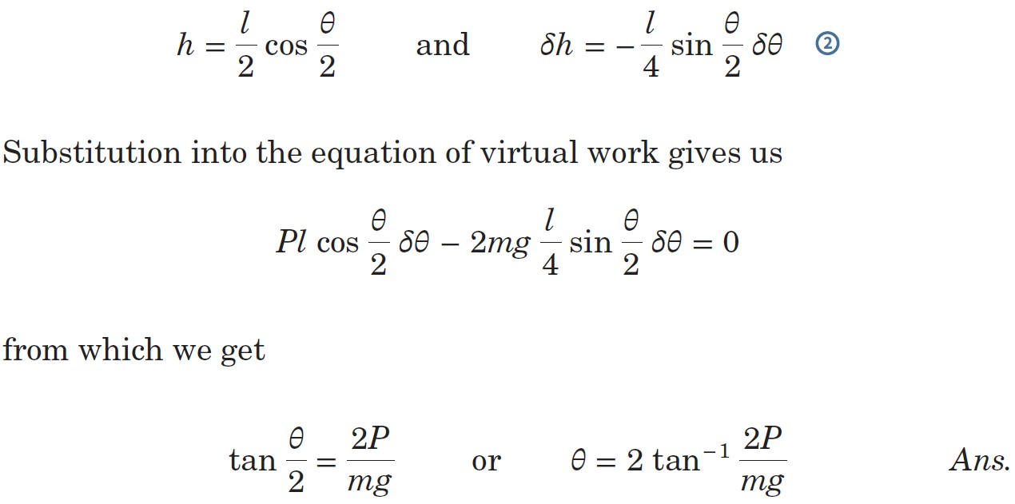
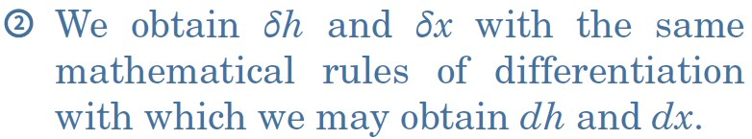
Article 7/3 – Sample Problem 7/1 (3 of 3)
Solution (cont.)

Slide 25
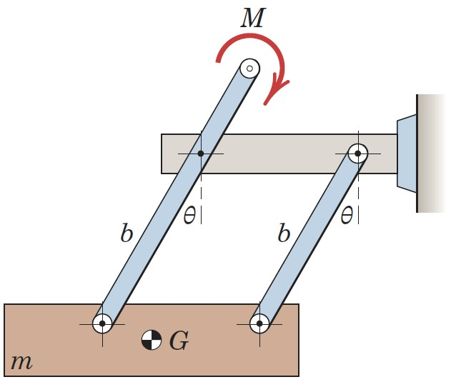
Article 7/3 – Sample Problem 7/2 (1 of 3)
Problem Statement
The mass m is brought to an equilibrium position by the application of the couple M to the end of one of the two parallel links which are hinged as shown. The links have negligible mass, and all friction is assumed to be absent. Determine the expression for the equilibrium angle 𝜃 assumed by the links with the vertical for a given value of M. Consider the alternative of a solution by force and moment equilibrium.

Slide 26
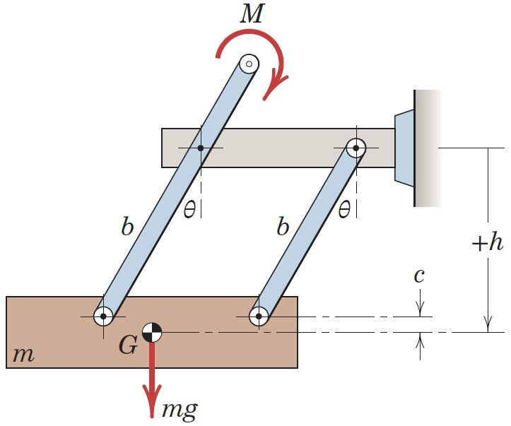
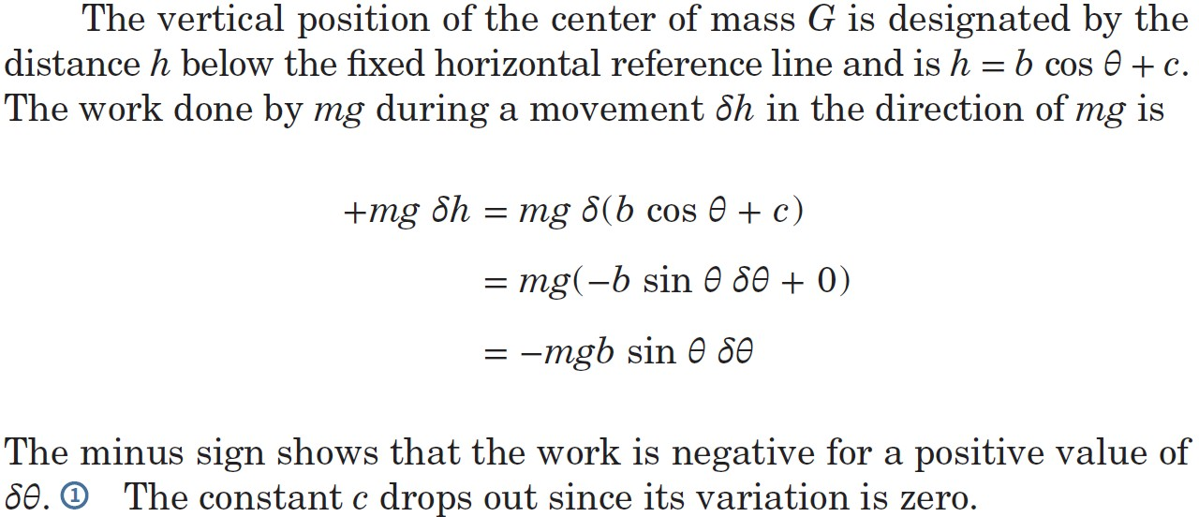
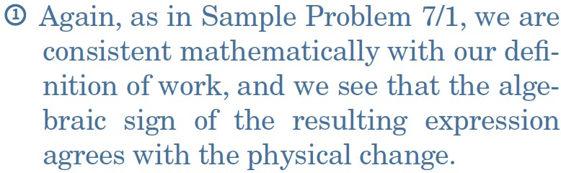
Article 7/3 – Sample Problem 7/2 (2 of 3)
Solution

Slide 27
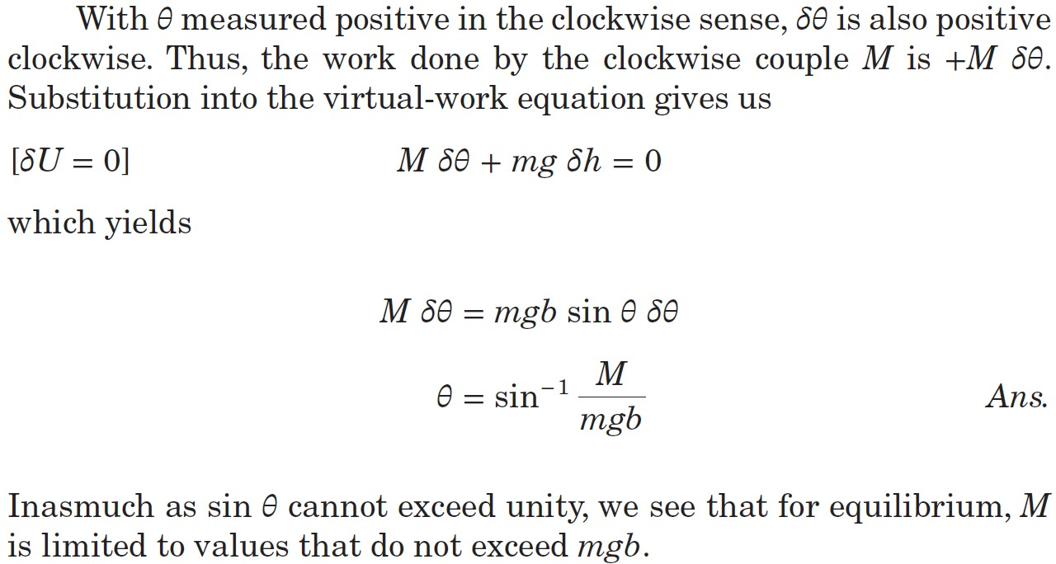
Article 7/3 – Sample Problem 7/2 (3 of 3)
Solution (cont.)

Slide 28
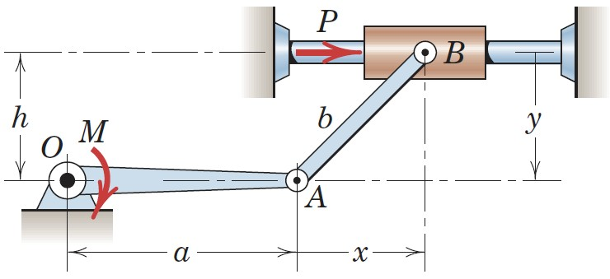
Article 7/3 – Sample Problem 7/3 (1 of 3)
Problem Statement
For link OA in the horizontal position shown, determine the force P on the sliding collar which will prevent OA from rotating under the action of the couple M. Neglect the mass of the moving parts.

Slide 29
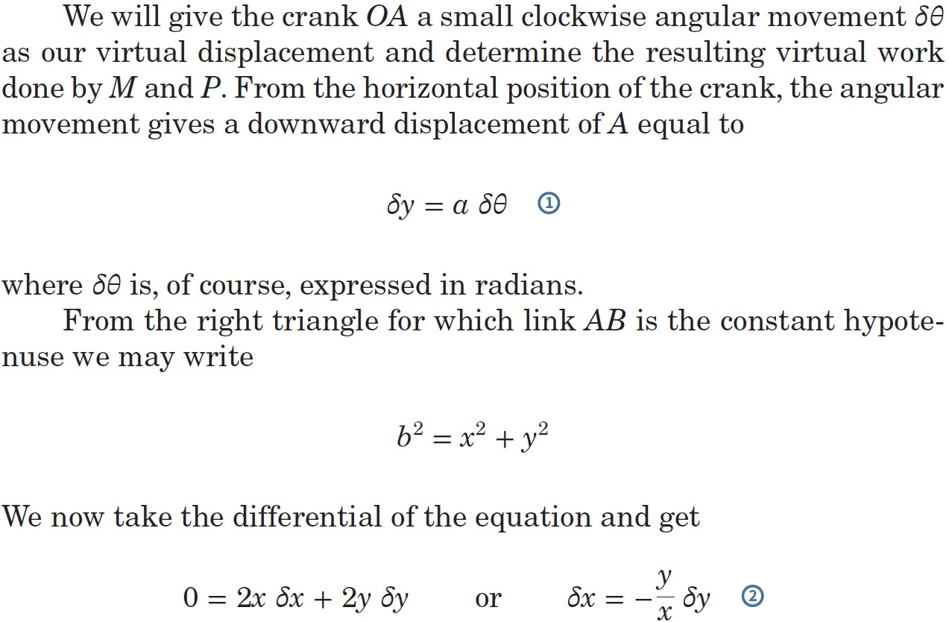
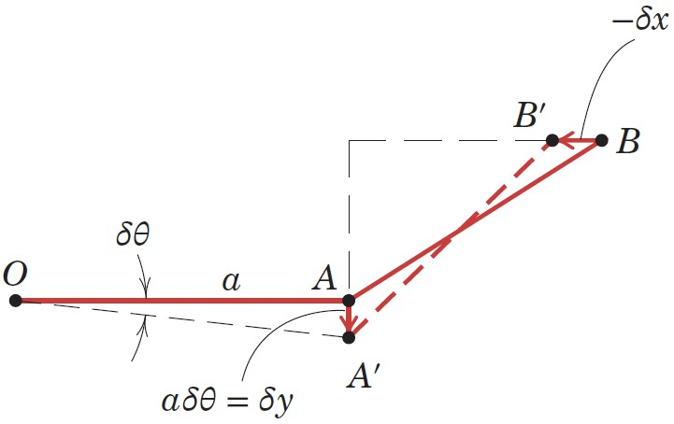
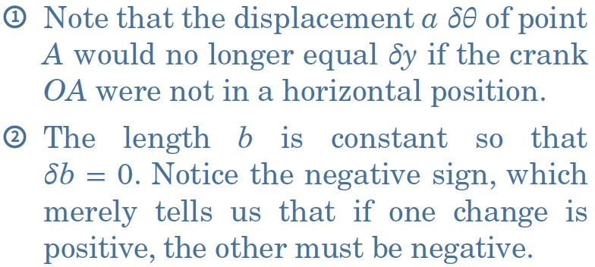
Article 7/3 – Sample Problem 7/3 (2 of 3)
Solution

Slide 30
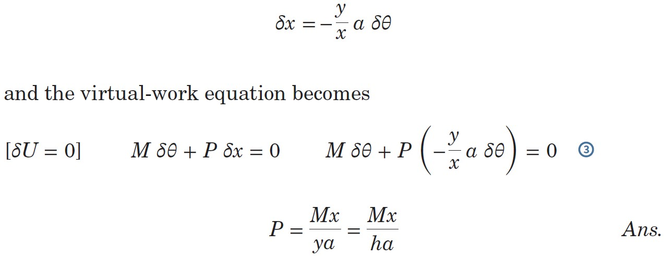
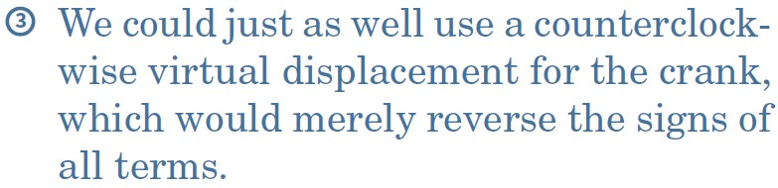
Article 7/3 – Sample Problem 7/3 (3 of 3)
Solution (cont.)
Thus,

Slide 31
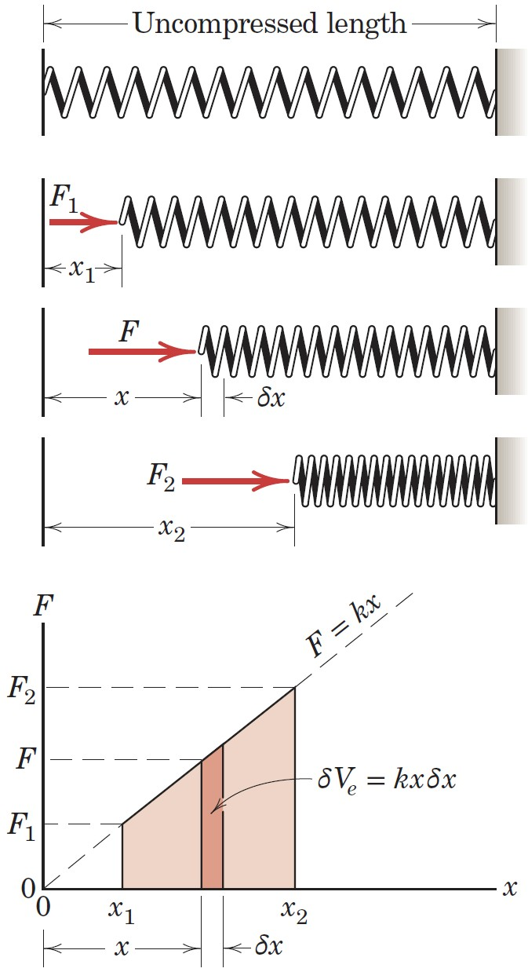
Article 7/4 Potential Energy and Stability
Elastic Potential Energy
Illustration
Linear Spring Stiffness, k
Spring Force, F = kx
Work done on the Spring, dU = F dx
Potential Energy, V_{e} = ½ kx²
Change in Potential Energy, ΔV_{e} = ½ k(x₂² - x₁²)

Slide 32
Article 7/4 – Elastic Potential Energy (cont.)
Virtual Displacements and Potential Energy
Virtual Displacement, δx
Virtual Change in Potential Energy, δV_{e} = F δx
Sign Convention
If the spring is compressed, the virtual change in elastic potential energy is negative.
If the spring is stretched, the virtual change in elastic potential energy is positive.
The work done on the body is the negative of the potential energy change of the spring.

Slide 33
Article 7/4 – Torsional Springs
A torsional spring resists rotation of a shaft or another element.
Torsional Stiffness, k_{T}
Units of torque per radian twist (N·m/rad or lb-ft/rad)
Elastic Potential Energy, V_{e} = ½ k_{T}θ²

Slide 34
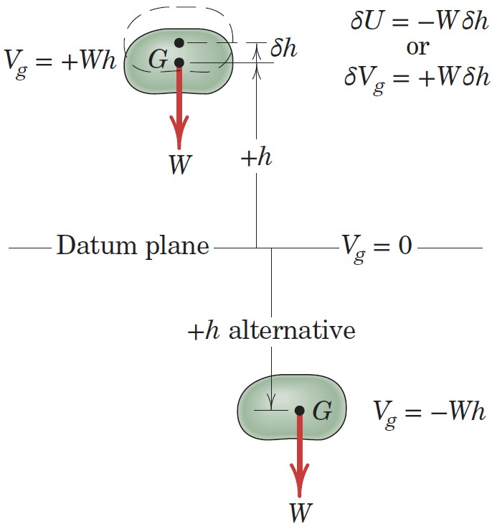
Article 7/4 – Gravitational Potential Energy (1 of 3)
Illustration & Definition
The gravitational potential energy V_{g} is defined as the work done on the body by a force equal and opposite to the weight in bringing the body to the position under consideration from some arbitrary datum plane where the potential energy is defined to be zero.
Potential Energy, V_{g} = mgh
Height h is measured from the datum.
Above the datum is considered positive.
Below the datum is considered negative.
Change in Potential Energy, ΔV_{g} = mg Δh

Slide 35
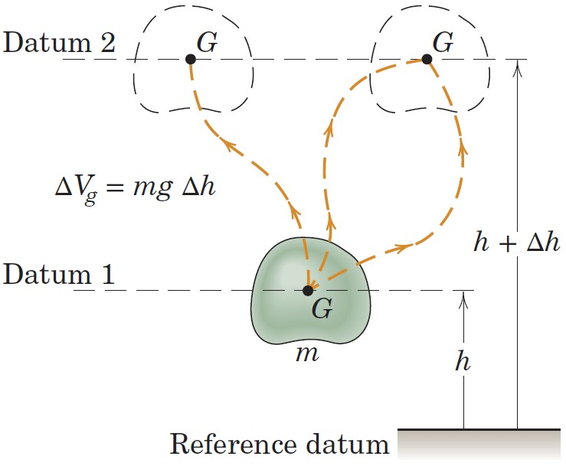
Article 7/4 – Gravitational Potential Energy (2 of 2)
Path Irrelevance

Slide 36
Article 7/4 – Gravitational Potential Energy (3 of 3)
Virtual Displacements and Potential Energy
Virtual Displacement, δh
Virtual Change in Potential Energy, δV_{g} = mg δh
Sign Convention
If the virtual displacement is upward, the sign of the virtual change in gravitational potential energy is positive.
If the virtual displacement is downward, the sign of the virtual change in gravitational potential energy is negative.
The work done on the body is the negative of the potential energy change of the body.

Slide 37
Article 7/4 – The Principle of Virtual Work Restated
The Equation Restated
The virtual work done by all external active forces (other than the gravitational and spring forces accounted for in the potential energy terms) on a mechanical system in equilibrium equals the corresponding change in the total elastic and gravitational potential energy of the system for any and all virtual displacements consistent with the constraints.
Mathematical Expression: δU′ – (δV_{e} + δV_{g}) = 0 or δU′ = δV
δU′ = sum of the work done by all active forces other than springs or weight.
-δV_{e} = work done by the spring forces.
-δV_{g} = work done by the weight forces.
δV = change in total elastic and gravitational potential energy of the system.
The equation above is also called the energy equation.

Slide 38
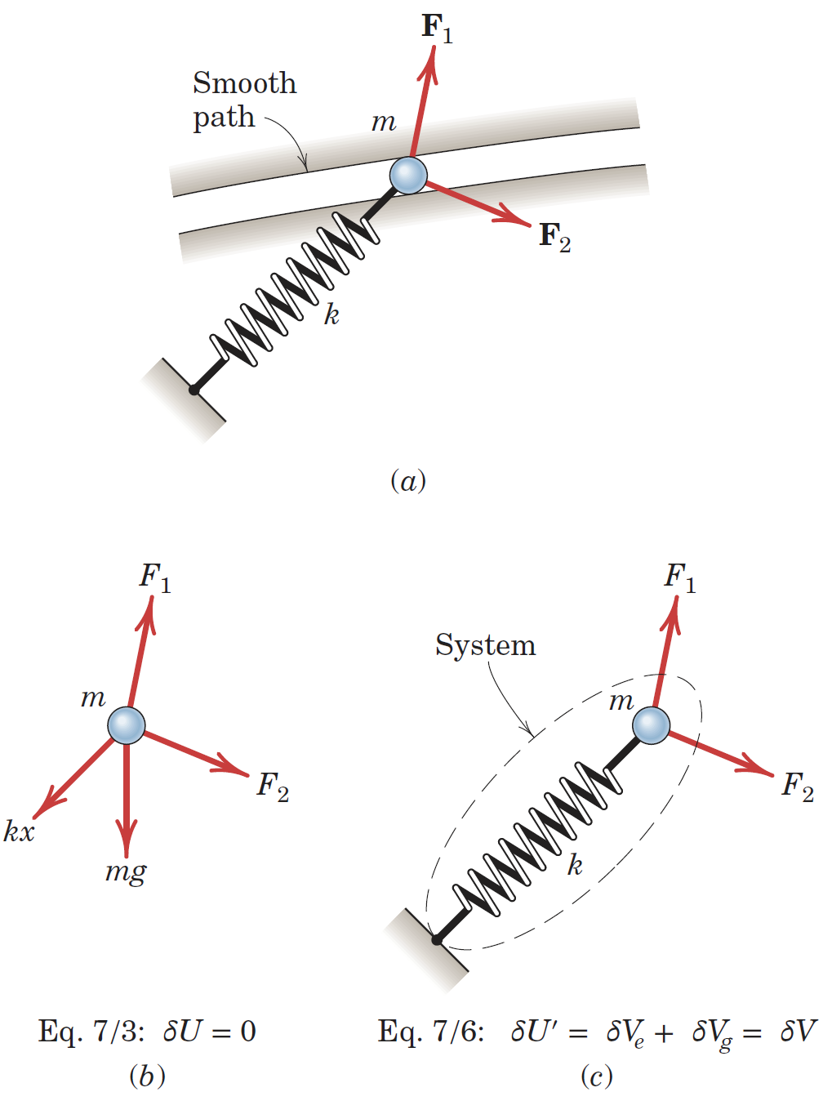
Article 7/4 – Active Force Diagrams
Illustration
(a) Body of Interest
(b) Use of Equation 7/3
(c) Use of Equation 7/6

Slide 39
Article 7/4 – Stability of Equilibrium (1 of 2)
Introduction
Consider a mechanical system where movement is accompanied by changes in gravitational and elastic potential energies and where no work is done on the system by nonpotential forces (δU′ = 0).
δU′ - (δV_{e} + δV_{g}) = 0 or (δV_{e} + δV_{g}) = 0 or δ (V_{e} + V_{g}) = 0 or δV = 0
The total potential energy V of the system is constant or has a stationary value.
One-Degree-of-Freedom System Implication
Potential energy is a function of some variable, x, and its derivatives.
Then…dV/dx = 0 for equilibrium.

Slide 40
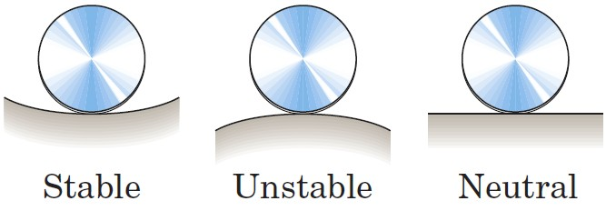
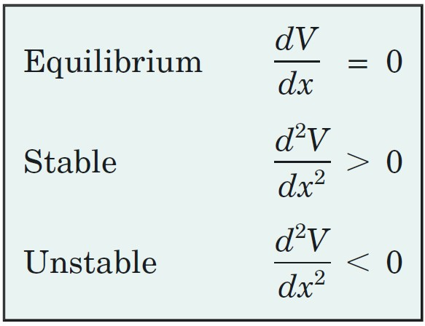
Article 7/4 – Stability of Equilibrium (2 of 2)
Conditions on Equilibrium
Stable: Total Potential Energy is a Minimum
Unstable: Total Potential Energy is a Maximum
Neutral: Total Potential Energy is a Constant
Mathematical Summary

Slide 41
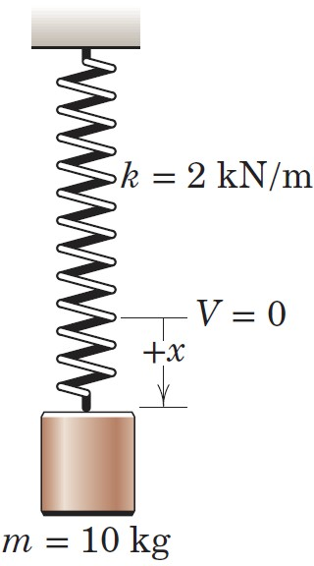
Article 7/4 – Sample Problem 7/4 (1 of 3)
Problem Statement
The 10-kg cylinder is suspended by the spring, which has a stiffness of 2 kN/m. Plot the potential energy V of the system and show that it is minimum at the equilibrium position.

Slide 42
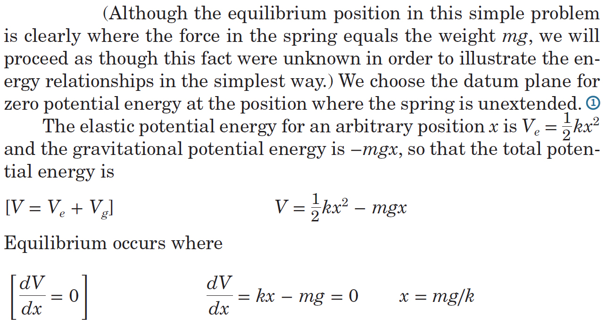

Article 7/4 – Sample Problem 7/4 (2 of 3)
Solution

Slide 43



Article 7/4 – Sample Problem 7/4 (3 of 3)
Solution (cont.)

Slide 44

Article 7/4 – Sample Problem 7/5 (1 of 3)
Problem Statement
The two uniform links, each of mass m, are in the vertical plane and are connected and constrained as shown. As the angle 𝜃 between the links increases with the application of the horizontal force P, the light rod, which is connected at A and passes through a pivoted collar at B, compresses the spring of stiffness k. If the spring is uncompressed in the position where 𝜃 = 0, determine the force P which will produce equilibrium at the angle 𝜃.

Slide 45

Article 7/4 – Sample Problem 7/5 (2 of 3)
Solution

Slide 46

Article 7/4 – Sample Problem 7/5 (2 of 3)
Solution (cont.)

Slide 47

Article 7/4 – Sample Problem 7/6 (1 of 4)
Problem Statement
The ends of the uniform bar of mass m slide freely in the horizontal and vertical guides. Examine the stability conditions for the positions of equilibrium. The spring of stiffness k is undeformed when x = 0.

Slide 48



Article 7/4 – Sample Problem 7/6 (2 of 4)
Solution

Slide 49



Article 7/4 – Sample Problem 7/6 (3 of 4)
Stability Equation
Stability Solution I

Slide 50


Article 7/4 – Sample Problem 7/6 (3 of 4)
Stability Solution II

